Slide 1

236781
Lecture 2-3
Deep learning
Convolutional Neural Networks
Dr. Chaim Baskin

Slide 2

Convolutional neural networks
Many slides from Rob Fergus, Andrej Karpathy

Slide 3
Outline
Building blocks
Convolutional layers
Pooling layers and nonlinearities
Architectures:
1st generation (2012-2013): AlexNet
2nd generation (2014): VGGNet, GoogLeNet
3rd generation (2015): ResNet
4th generation (2016): Wide ResNet, ResNeXt, DenseNet

Slide 4
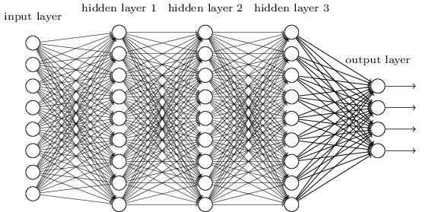
Let’s design a neural network for images
This kind of design is known as multi-layer perceptron (MLP)
image
Fully connected layer

Slide 5
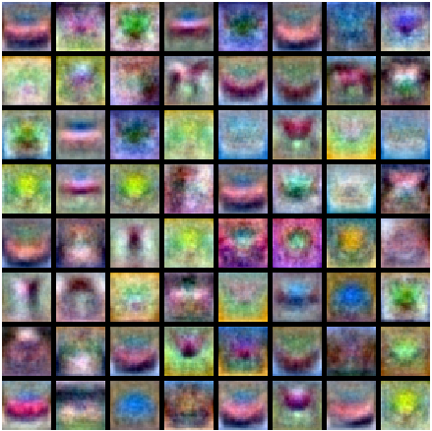
Let’s design a neural network for images
This kind of design is known as multi-layer perceptron (MLP)
What is wrong with this?
Recall: MLP as bank of whole-image templates
image
Fully connected layer

Slide 6
Convolutional architecture
Let’s limit the receptive fields of units, tile them over the input image, and share their weights
image

Slide 7
Convolutional architecture
Let’s limit the receptive fields of units, tile them over the input image, and share their weights
image

Slide 8
Convolutional architecture
feature map
learned weights
Let’s limit the receptive fields of units, tile them over the input image, and share their weights
This is equivalent to sliding the learned filter over the image, computing dot products at every location
image

Slide 9
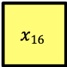
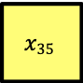
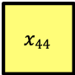
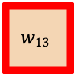
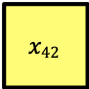
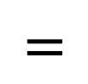
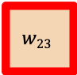
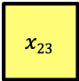
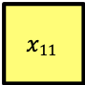
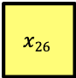
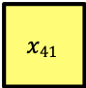

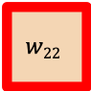
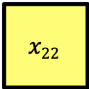
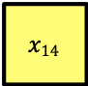
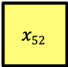
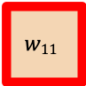
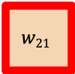
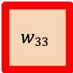
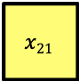
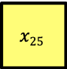
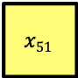

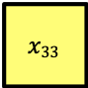


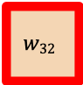
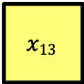

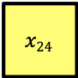

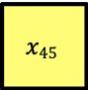
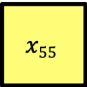




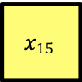



Convolution example
Input
Filter
Output
$$x11$$
$$x12$$
$$x13$$
$$x14$$
$$x15$$
$$x16$$
$$x21$$
$$x22$$
$$x23$$
$$x24$$
$$x25$$
$$x26$$
$$w11$$
$$w12$$
$$w13$$
$$x31$$
$$x32$$
$$x33$$
$$x34$$
$$x35$$
$$x36$$
$$∗$$
$$w21$$
$$w22$$
$$w23$$
$$=$$
$$x41$$
$$x42$$
$$x43$$
$$x44$$
$$x45$$
$$x46$$
$$w31$$
$$w32$$
$$w33$$
$$x51$$
$$x52$$
$$x53$$
$$x54$$
$$x55$$
$$x56$$
Adapted from D. Fouhey and J. Johnson

Slide 10
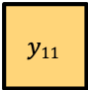
Convolution example
Input
Filter
Output
$$x11$$
$$x12$$
$$x13$$
$$x14$$
$$x15$$
$$x16$$
$$x21$$
$$x22$$
$$x23$$
$$x24$$
$$x25$$
$$x26$$
$$w11$$
$$w12$$
$$w13$$
$$y11$$
$$x31$$
$$x32$$
$$x33$$
$$x34$$
$$x35$$
$$x36$$
$$∗$$
$$w21$$
$$w22$$
$$w23$$
$$=$$
$$x41$$
$$x42$$
$$x43$$
$$x44$$
$$x45$$
$$x46$$
$$w31$$
$$w32$$
$$w33$$
$$x51$$
$$x52$$
$$x53$$
$$x54$$
$$x55$$
$$x56$$
$$y11 =x11∙w11 +x12∙w12+x13∙w13+ … +x33∙w33$$
Adapted from D. Fouhey and J. Johnson

Slide 11
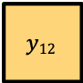
Convolution example
Input
Filter
Output
$$x11$$
$$x12$$
$$x13$$
$$x14$$
$$x15$$
$$x16$$
$$x21$$
$$x22$$
$$x23$$
$$x24$$
$$x25$$
$$x26$$
$$w11$$
$$w12$$
$$w13$$
$$y11$$
$$y12$$
$$x31$$
$$x32$$
$$x33$$
$$x34$$
$$x35$$
$$x36$$
$$∗$$
$$w21$$
$$w22$$
$$w23$$
$$=$$
$$x41$$
$$x42$$
$$x43$$
$$x44$$
$$x45$$
$$x46$$
$$w31$$
$$w32$$
$$w33$$
$$x51$$
$$x52$$
$$x53$$
$$x54$$
$$x55$$
$$x56$$
$$y12 =x12∙w11 +x13∙w12+x14∙w13+ … +x34∙w33$$
Adapted from D. Fouhey and J. Johnson

Slide 12
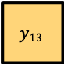
Convolution example
Input
Filter
Output
$$x11$$
$$x12$$
$$x13$$
$$x14$$
$$x15$$
$$x16$$
$$x21$$
$$x22$$
$$x23$$
$$x24$$
$$x25$$
$$x26$$
$$w11$$
$$w12$$
$$w13$$
$$y11$$
$$y12$$
$$y13$$
$$x31$$
$$x32$$
$$x33$$
$$x34$$
$$x35$$
$$x36$$
$$∗$$
$$w21$$
$$w22$$
$$w23$$
$$=$$
$$x41$$
$$x42$$
$$x43$$
$$x44$$
$$x45$$
$$x46$$
$$w31$$
$$w32$$
$$w33$$
$$x51$$
$$x52$$
$$x53$$
$$x54$$
$$x55$$
$$x56$$
$$y13 =x13∙w11 +x14∙w12+x15∙w13+ … +x35∙w33$$
Adapted from D. Fouhey and J. Johnson

Slide 13
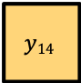
Convolution example
Input
Filter
Output
$$x11$$
$$x12$$
$$x13$$
$$x14$$
$$x15$$
$$x16$$
$$x21$$
$$x22$$
$$x23$$
$$x24$$
$$x25$$
$$x26$$
$$w11$$
$$w12$$
$$w13$$
$$y11$$
$$y12$$
$$y13$$
$$y14$$
$$x31$$
$$x32$$
$$x33$$
$$x34$$
$$x35$$
$$x36$$
$$∗$$
$$w21$$
$$w22$$
$$w23$$
$$=$$
$$x41$$
$$x42$$
$$x43$$
$$x44$$
$$x45$$
$$x46$$
$$w31$$
$$w32$$
$$w33$$
$$x51$$
$$x52$$
$$x53$$
$$x54$$
$$x55$$
$$x56$$
$$y14 =x14∙w11 +x15∙w12+x16∙w13+ … +x36∙w33$$
Adapted from D. Fouhey and J. Johnson

Slide 14
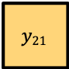
Convolution example
Input
Filter
Output
$$x11$$
$$x12$$
$$x13$$
$$x14$$
$$x15$$
$$x16$$
$$x21$$
$$x22$$
$$x23$$
$$x24$$
$$x25$$
$$x26$$
$$w11$$
$$w12$$
$$w13$$
$$y11$$
$$y12$$
$$y13$$
$$y14$$
$$x31$$
$$x32$$
$$x33$$
$$x34$$
$$x35$$
$$x36$$
$$∗$$
$$w21$$
$$w22$$
$$w23$$
$$=$$
$$y21$$
$$x41$$
$$x42$$
$$x43$$
$$x44$$
$$x45$$
$$x46$$
$$w31$$
$$w32$$
$$w33$$
$$x51$$
$$x52$$
$$x53$$
$$x54$$
$$x55$$
$$x56$$
$$y21 =x21∙w11 +x22∙w12+x23∙w13+ … +x43∙w33$$
Adapted from D. Fouhey and J. Johnson

Slide 15
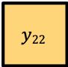
Convolution example
Input
Filter
Output
$$x11$$
$$x12$$
$$x13$$
$$x14$$
$$x15$$
$$x16$$
$$x21$$
$$x22$$
$$x23$$
$$x24$$
$$x25$$
$$x26$$
$$w11$$
$$w12$$
$$w13$$
$$y11$$
$$y12$$
$$y13$$
$$y14$$
$$x31$$
$$x32$$
$$x33$$
$$x34$$
$$x35$$
$$x36$$
$$∗$$
$$w21$$
$$w22$$
$$w23$$
$$=$$
$$y21$$
$$y22$$
$$x41$$
$$x42$$
$$x43$$
$$x44$$
$$x45$$
$$x46$$
$$w31$$
$$w32$$
$$w33$$
$$x51$$
$$x52$$
$$x53$$
$$x54$$
$$x55$$
$$x56$$
$$y22 =x22∙w11 +x23∙w12+x24∙w13+ … +x44∙w33$$
Adapted from D. Fouhey and J. Johnson

Slide 16
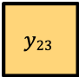
Convolution example
Input
Filter
Output
$$x11$$
$$x12$$
$$x13$$
$$x14$$
$$x15$$
$$x16$$
$$x21$$
$$x22$$
$$x23$$
$$x24$$
$$x25$$
$$x26$$
$$w11$$
$$w12$$
$$w13$$
$$y11$$
$$y12$$
$$y13$$
$$y14$$
$$x31$$
$$x32$$
$$x33$$
$$x34$$
$$x35$$
$$x36$$
$$∗$$
$$w21$$
$$w22$$
$$w23$$
$$=$$
$$y21$$
$$y22$$
$$y23$$
$$x41$$
$$x42$$
$$x43$$
$$x44$$
$$x45$$
$$x46$$
$$w31$$
$$w32$$
$$w33$$
$$x51$$
$$x52$$
$$x53$$
$$x54$$
$$x55$$
$$x56$$
$$y23 =x23∙w11 +x24∙w12+x25∙w13+ … +x45∙w33$$
Adapted from D. Fouhey and J. Johnson

Slide 17
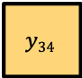
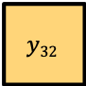
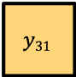
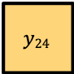
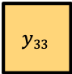
Convolution example
Input
Filter
Output
$$x11$$
$$x12$$
$$x13$$
$$x14$$
$$x15$$
$$x16$$
$$x21$$
$$x22$$
$$x23$$
$$x24$$
$$x25$$
$$x26$$
$$w11$$
$$w12$$
$$w13$$
$$y11$$
$$y12$$
$$y13$$
$$y14$$
$$x31$$
$$x32$$
$$x33$$
$$x34$$
$$x35$$
$$x36$$
$$∗$$
$$w21$$
$$w22$$
$$w23$$
$$=$$
$$y21$$
$$y22$$
$$y23$$
$$y24$$
$$x41$$
$$x42$$
$$x43$$
$$x44$$
$$x45$$
$$x46$$
$$w31$$
$$w32$$
$$w33$$
$$y31$$
$$y32$$
$$y33$$
$$y34$$
$$x51$$
$$x52$$
$$x53$$
$$x54$$
$$x55$$
$$x56$$
Adapted from D. Fouhey and J. Johnson

Slide 18

Convolutional architecture
feature map
Output feature map resolution depends on padding and stride
learned weights
Output
Input
image
No padding, stride 1
Animation source

Slide 19

Convolutional architecture
feature map
Output feature map resolution depends on padding and stride
learned weights
Output
Input
image
With padding, stride 1
Animation source

Slide 20

Convolutional architecture
feature map
Output feature map resolution depends on padding and stride
learned weights
Output
Input
image
With padding, stride 2

Slide 21
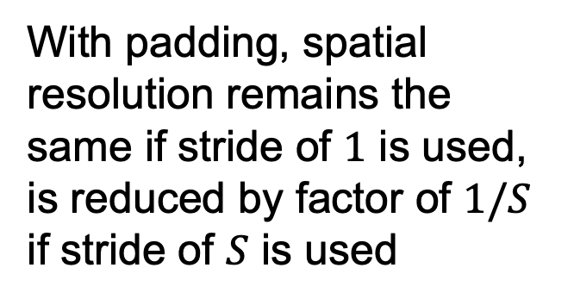
Convolutional architecture
feature map
Output feature map resolution depends on padding and stride
learned weights
With padding, spatial resolution remains the same if stride of $1$ is used, is reduced by factor of $1/S$ if stride of $S$ is used
image

Slide 22
Convolutional architecture
feature map
learned weights
image

Slide 23
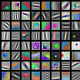
Convolutional architecture
another feature map
another set of learned weights
Learned weights can be thought of as local templates
image

Slide 24
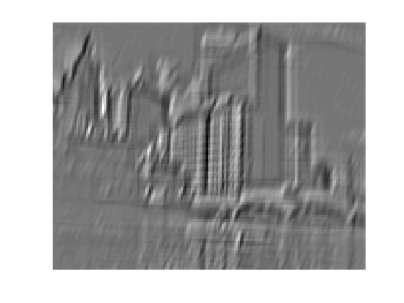
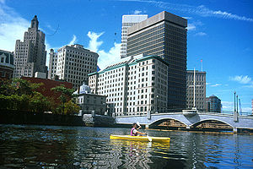
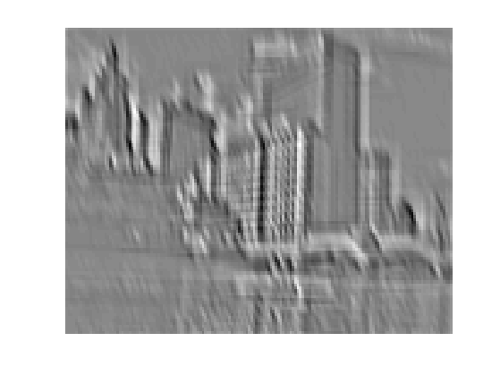
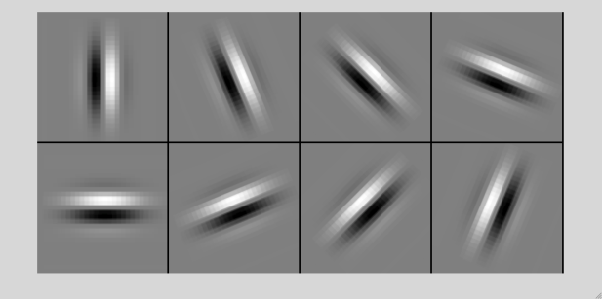
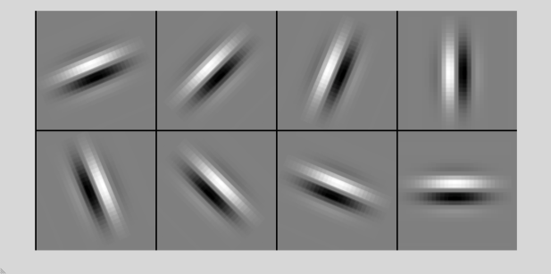

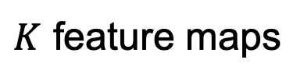
Convolution and traditional feature extraction
bank of $K$ filters
$K$ feature maps
...
image
feature map

Slide 25


Convolutional layer anatomy
$K$ feature maps
$K$ filters
Convolutional layers are almost always directly followed by a ReLU
image
convolutional layer

Slide 26

Convolutional layer anatomy
$K$ feature maps
How do we put another convolutional layer on top of a stack of $K$ feature maps?

Slide 27


Convolutional layer anatomy
$K$ feature maps
One output feature map
$$F×F×K$$
filter

Slide 28


Convolutional layer anatomy
$K$ feature maps
$L$ output feature maps
$$F×F×K$$
filter
$L$ filters

Slide 29

Convolutional layer example
Stride = 2
Animation:
http://cs231n.github.io/convolutional-networks/#conv

Slide 30
Convolutional layer example
?
Stride = 2
Animation:
http://cs231n.github.io/convolutional-networks/#conv

Slide 31
Convolutional layer: Details
Efficient implementation: reshape all image neighborhoods into columns (im2col operation), do matrix-vector multiplication
Image source

Slide 32
Convolutional layer: Details
Efficient implementation: reshape all image neighborhoods into columns (im2col operation), do matrix-vector multiplication
Backward pass: special case of linear layer, operations also turn out to be convolutions
Downstream gradient (of error w.r.t. input) is a transposed convolution, or convolution of output with filter flipped both horizontally and vertically

Slide 33




Max pooling layer
$K$ feature maps, resolution $1/S$
$K$ feature maps
max value
$F × F$ pooling window, stride $S$
Backward pass: upstream gradient is passed back only to the unit with max value
Usually: $F=2$ or $3$, $S=2$

Slide 34

Max pooling: Example
Single channel
1 | 1 | 2 | 4
5 | 6 | 7 | 8
3 | 2 | 1 | 0
1 | 2 | 3 | 4
Max pooling with $2×2$ kernel size and stride 2
Source: J. Johnson

Slide 35
Max pooling: Example
Single channel
1 | 1 | 2 | 4
5 | 6 | 7 | 8
3 | 2 | 1 | 0
1 | 2 | 3 | 4
Max pooling with $2×2$ kernel size and stride 2
Source: J. Johnson

Slide 36
Max pooling: Example
Single channel
1 | 1 | 2 | 4
5 | 6 | 7 | 8
3 | 2 | 1 | 0
1 | 2 | 3 | 4
Max pooling with $2×2$ kernel size and stride 2
6 | 8
3 | 4
Source: J. Johnson

Slide 37
Summary: CNN pipeline
Feature maps
Spatial pooling
Non-linearity
Convolution (Learned)
...
Input Image
Input
Feature Map
Source: R. Fergus, Y. LeCun

Slide 38



Summary: CNN pipeline
Feature maps
Spatial pooling
Non-linearity
Convolution (Learned)
Input Image
Source: R. Fergus, Y. LeCun
Source: Stanford 231n

Slide 39


Summary: CNN pipeline
Feature maps
Max (or Avg)
Spatial pooling
Non-linearity
Convolution (Learned)
Input Image
Source: R. Fergus, Y. LeCun

Slide 40

Summary: CNN pipeline
Softmax layer:

Slide 41
Receptive field
3x3 convolutions, stride 1
Input
Output
The receptive field of a unit is the region of the input feature map whose values contribute to the response of that unit (either in the previous layer or in the initial image)
Receptive field size: 3

Slide 42
Receptive field
3x3 convolutions, stride 1
Input
Output
Receptive field size: 5

Slide 43

Receptive field
3x3 convolutions, stride 1
Input
Output
Receptive field size: 7
Each successive convolution adds $F – 1$ to the receptive field size
With $L$ layers the receptive field size is $1 +L ∗ (F – 1)$

Slide 44
Receptive field
3x3 convolutions, stride 2
Input
Output
Receptive field size: 3

Slide 45
Receptive field
3x3 convolutions, stride 2
Input
Output

Slide 46

Receptive field
3x3 convolutions, stride 2
Input
Output
Receptive field size: 7
With a stride of 2, receptive field size is given by $2^{L+1}−1$, i.e., it grows exponentially (though spatial resolution decreases exponentially)

Slide 47

Backstory
Biological inspiration: D. Hubel and T. Wiesel (1959, 1962, Nobel Prize 1981)
Visual cortex consists of a hierarchy of simple, complex, and hyper-complex cells
Source

Slide 48

Backstory
Neocognitron
LeNet-5
K. Fukishima. Neocognitron: A Self-organizing Neural Network Model for a Mechanism of Pattern Recognition Unaffected by Shift in Position. Biological Cybernetics, 1980
Y. LeCun, L. Bottou, Y. Bengio, and P. Haffner, Gradient-based learning applied to document recognition, Proc. IEEE 86(11): 2278–2324, 1998

Slide 49
Convolutional networks: Outline
Building blocks
Convolutional layers
Pooling layers and nonlinearities
Architectures:
1st generation (2012-2013): AlexNet
2nd generation (2014): VGGNet, GoogLeNet
3rd generation (2015): ResNet
4th generation (2016): WideResNet, ResNeXt, DenseNet

Slide 50
ImageNet Challenge
ILSVRC
Figure source

Slide 51


AlexNet: ILSVRC 2012 winner
Successor of LeNet-5 with a few crucial changes:
Max pooling, ReLU nonlinearity
Dropout regularization
More data and bigger model (7 hidden layers, 650K units, 60M params)
GPU implementation (50x speedup over CPU)
Trained on two GPUs for a week
A. Krizhevsky, I. Sutskever, and G. Hinton, ImageNet Classification with Deep Convolutional Neural Networks, NIPS 2012
Notes:
Two-GPU architecture

Slide 52
AlexNet by the numbers
 | Input size |  | Layer |  |  |  | Output size
Layer | C | H / W | filters | kernel | stride | pad | C | H / W | memory (KB) | params (k) | flop (M)
conv1 | 3 | 227 | 64 | 11 | 4 | 2 | 64 | 56 | 784 | 23 | 73
pool1 | 64 | 56 |  | 3 | 2 | 0 | 64 | 27 | 182 | 0 | 0
conv2 | 64 | 27 | 192 | 5 | 1 | 2 | 192 | 27 | 547 | 307 | 224
pool2 | 192 | 27 |  | 3 | 2 | 0 | 192 | 13 | 127 | 0 | 0
conv3 | 192 | 13 | 384 | 3 | 1 | 1 | 384 | 13 | 254 | 664 | 112
conv4 | 384 | 13 | 256 | 3 | 1 | 1 | 256 | 13 | 169 | 885 | 145
conv5 | 256 | 13 | 256 | 3 | 1 | 1 | 256 | 13 | 169 | 590 | 100
pool5 | 256 | 13 |  | 3 | 2 | 0 | 256 | 6 | 36 | 0 | 0
flatten | 256 | 6 |  |  |  |  | 9216 |  | 36 | 0 | 0
fc6 | 9216 |  | 4096 |  |  |  | 4096 |  | 16 | 37,749 | 38
fc7 | 4096 |  | 4096 |  |  |  | 4096 |  | 16 | 16,777 | 17
fc8 | 4096 |  | 1000 |  |  |  | 1000 |  | 4 | 4,096 | 4
Source: J. Johnson

Slide 53
AlexNet by the numbers
FC6 input size:
6 x 6 x 256 = 9216
Output size: 4096
Params: 9216 x 4096 = 37,749K
Most of the memory usage is in the early convolution layers
Nearly all parameters are in the fully-connected layers
Most floating-point ops occur in the convolution layers
Source: J. Johnson

Slide 54

Clarifai or ZFNet: ILSVRC 2013 winner
Refinement of AlexNet
M. Zeiler and R. Fergus, Visualizing and Understanding Convolutional Networks, ECCV 2014 (Best Paper Award winner)

Slide 55
Outline
Building blocks
Convolutional layers
Pooling layers and nonlinearities
Architectures:
1st generation (2012-2013): AlexNet
2nd generation (2014): VGGNet, GoogLeNet
3rd generation (2015): ResNet
4th generation (2016): ResNeXt, DenseNet

Slide 56

VGGNet: ILSVRC 2014 2nd place
Image source
K. Simonyan and A. Zisserman, Very Deep Convolutional Networks for Large-Scale Image Recognition, ICLR 2015
Notes:
LRN – local response normalization (doesn’t improve performance)

Slide 57



VGGNet: ILSVRC 2014 2nd place
Sequence of deeper networks trained progressively
Large receptive fields replaced by successive layers of $3×3$ convolutions (with ReLU in between)
How many weights does one $7×7$ conv layer with $K$ input and output channels have?
$49K2$
What about three $3×3$ conv layers with $K$ input and output channels?
$27K2$
All maxpool layers are $2×2$ stride $2$, followed by doubling of the number of channels (keeping cost of convolutions the same)
Notes:
LRN – local response normalization (doesn’t improve performance)

Slide 58
VGGNet vs. AlexNet
AlexNet total: 1.9 MB
VGG-16 total: 48.6 MB (25x)
AlexNet total: 61M
VGG-16 total: 138M (2.3x)
AlexNet total: 0.7 GFLOP
VGG-16 total: 13.6 GFLOP (19.4x)
Source: J. Johnson

Slide 59


GoogLeNet: ILSVRC 2014 winner
http://knowyourmeme.com/memes/we-need-to-go-deeper
C. Szegedy et al., Going deeper with convolutions, CVPR 2015

Slide 60
GoogLeNet: Aggressive stem
Stem network at the start aggressively downsamples input
Source: J. Johnson

Slide 61
GoogLeNet: Aggressive stem
Stem network at the start aggressively downsamples input
 | Input size |  | Layer |  |  |  | Output size
Layer | C | H / W | filters | kernel | stride | pad | C | H/W | memory (KB) | params (K) | flop (M)
conv | 3 | 224 | 64 | 7 | 2 | 3 | 64 | 112 | 3136 | 9 | 118
max-pool | 64 | 112 |  | 3 | 2 | 1 | 64 | 56 | 784 | 0 | 2
conv | 64 | 56 | 64 | 1 | 1 | 0 | 64 | 56 | 784 | 4 | 13
conv | 64 | 56 | 192 | 3 | 1 | 1 | 192 | 56 | 2352 | 111 | 347
max-pool | 192 | 56 |  | 3 | 2 | 1 | 192 | 28 | 588 | 0 | 1
Total from 224 to 28 resolution:
Memory: 7.5 MB
Params: 124K
MFLOP: 418
Source: J. Johnson

Slide 62
GoogLeNet: Aggressive stem
Compare VGG-16:
Memory: 42.9 MB (5.7x)
Params: 1.1M (8.9x)
MFLOP: 7485 (17.8x)
Total from 224 to 28 resolution:
Memory: 7.5 MB
Params: 124K
MFLOP: 418
Source: J. Johnson

Slide 63

GoogLeNet: Inception module
Parallel paths with different receptive field sizes and operations are meant to capture sparse patterns of correlations in the stack of feature maps
Use 1x1 convolutions for dimensionality reduction before expensive convolutions
Source: J. Johnson

Slide 64




Recall: Regular conv layer
$K$ feature maps
$L$ feature maps
$F×F×K$ filter
$L$ filters
conv layer

Slide 65



1x1 convolution
$K$ feature maps
$L$ feature maps
$1×1×K$ filter
$L$ filters
$1×1$ conv layer

Slide 66

1x1 convolution
“network in network”
M. Lin, Q. Chen, and S. Yan, Network in network, ICLR 2014

Slide 67



Network in network
M. Lin, Q. Chen, and S. Yan, Network in network, ICLR 2014

Slide 68
GoogLeNet: Global average pooling
Instead of large FC layers at the end, use global average pooling to collapse spatial dimensions, followed by linear layer to produce class scores
Recall VGG-16: Most parameters were in the FC layers!
Source: J. Johnson

Slide 69
GoogLeNet: Global average pooling
GoogLeNet head:
 | Input size |  | Layer |  |  |  | Output size
Layer | C | H/W | filters | kernel | stride | pad | C | H/W | memory (KB) | params (k) | flop (M)
avg-pool | 1024 | 7 |  | 7 | 1 | 0 | 1024 | 1 | 4 | 0 | 0
fc | 1024 |  | 1000 |  |  |  | 1000 |  | 0 | 1025 | 1
Source: J. Johnson

Slide 70
GoogLeNet: Global average pooling
GoogLeNet head:
 | Input size |  | Layer |  |  |  | Output size
Layer | C | H/W | filters | kernel | stride | pad | C | H/W | memory (KB) | params (k) | flop (M)
avg-pool | 1024 | 7 |  | 7 | 1 | 0 | 1024 | 1 | 4 | 0 | 0
fc | 1024 |  | 1000 |  |  |  | 1000 |  | 0 | 1025 | 1
Layer | C | H/W | filters | kernel | stride | pad | C | H/W | memory (KB) | params (k) | flop (M)
flatten | 512 | 7 |  |  |  |  | 25088 |  | 98
fc6 | 25088 |  |  | 4096 |  |  | 4096 |  | 16 | 102760 | 103
fc7 | 4096 |  |  | 4096 |  |  | 4096 |  | 16 | 16777 | 17
fc8 | 4096 |  |  | 1000 |  |  | 1000 |  | 4 | 4096 | 4
Compare with VGG-16:
Source: J. Johnson

Slide 71
GoogLeNet: Auxiliary classifiers
Training using loss at the end of the network didn’t work well: network is too deep, gradients don’t propagate cleanly
As a hack, attach “auxiliary classifiers” at several intermediate points in the network that also try to classify the image and receive loss
GoogLeNet was before batch normalization! With BatchNorm no longer need to use this trick
Source: J. Johnson

Slide 72

GoogLeNet
An alternative view:
C. Szegedy et al., Going deeper with convolutions, CVPR 2015

Slide 73



Inception v2, v3
Improve training with batch normalization, eliminating need for auxiliary classifiers
More variants of inception modules with aggressive factorization of filters
C. Szegedy et al., Rethinking the inception architecture for computer vision, CVPR 2016

Slide 74
ImageNet Challenge 2012-2014
Team | Year | Place | Error (top-5) | External data
SuperVision – Toronto (7 layers) | 2012 | - | 16.4% | no
SuperVision | 2012 | 1st | 15.3% | ImageNet 22k
Clarifai – NYU (7 layers) | 2013 | - | 11.7% | no
Clarifai | 2013 | 1st | 11.2% | ImageNet 22k
VGG – Oxford (16 layers) | 2014 | 2nd | 7.32% | no
GoogLeNet (19 layers) | 2014 | 1st | 6.67% | no
Human expert* |  |  | 5.1%
http://karpathy.github.io/2014/09/02/what-i-learned-from-competing-against-a-convnet-on-imagenet/
Notes:
Best non-convnet in 2012: 26.2%

Slide 75
Convolutional networks: Outline
Building blocks
Convolutional layers
Pooling layers and nonlinearities
Architectures:
1st generation (2012-2013): AlexNet
2nd generation (2014): VGGNet, GoogLeNet
3rd generation (2015): ResNet
4th generation (2016): ResNeXt, DenseNet

Slide 76

ResNet: ILSVRC 2015 winner
K. He, X. Zhang, S. Ren, and J. Sun, Deep Residual Learning for Image Recognition, CVPR 2016 (Best Paper)

Slide 77
ResNet: ILSVRC 2015 winner
K. He, X. Zhang, S. Ren, and J. Sun, Deep Residual Learning for Image Recognition, CVPR 2016 (Best Paper)

Slide 78

Source (?)

Slide 79

ResNet
The residual module
Introduce skip or shortcut connections (existing before in various forms in literature)
Make it easy for network layers to represent the identity mapping
K. He, X. Zhang, S. Ren, and J. Sun, Deep Residual Learning for Image Recognition, CVPR 2016 (Best Paper)

Slide 80

ResNet
Deeper residual module (bottleneck)
Directly performing 3x3 convolutions with 256 feature maps at input and output: 256 x 256 x 3 x 3 ~ 600K operations
Using 1x1 convolutions to reduce 256 to 64 feature maps, followed by 3x3 convolutions, followed by 1x1 convolutions to expand back to 256 maps: 256 x 64 x 1 x 1 ~ 16K 64 x 64 x 3 x 3 ~ 36K 64 x 256 x 1 x 1 ~ 16K Total: ~70K
K. He, X. Zhang, S. Ren, and J. Sun, Deep Residual Learning for Image Recognition, CVPR 2016 (Best Paper)

Slide 81

ResNet
Architectures for ImageNet:
K. He, X. Zhang, S. Ren, and J. Sun, Deep Residual Learning for Image Recognition, CVPR 2016 (Best Paper)

Slide 82

Why do ResNets work?
ResNets are collections of many paths of different length, and shorter paths predominantly contribute to training
A. Veit, M. Wilber, S. Belongie, Residual Networks Behave Like Ensembles of Relatively Shallow Networks, NIPS 2016
Notes:
In this work we propose a novel interpretation of residual networks showing that they can be seen as a collection of many paths of differing length. Moreover, residual networks seem to enable very deep networks by leveraging only the short paths during training. To support this observation, we rewrite residual networks as an explicit collection of paths. Unlike traditional models, paths through residual networks vary in length. Further, a lesion study reveals that these paths show ensemble-like behavior in the sense that they do not strongly depend on each other. Finally, and most surprising, most paths are shorter than one might expect, and only the short paths are needed during training, as longer paths do not contribute any gradient. For example, most of the gradient in a residual network with 110 layers comes from paths that are only 10-34 layers deep. Our results reveal one of the key characteristics that seem to enable the training of very deep networks: Residual networks avoid the vanishing gradient problem by introducing short paths which can carry gradient throughout the extent of very deep networks.

Slide 83

Inception v4
C. Szegedy et al., Inception-v4, Inception-ResNet and the Impact of Residual Connections on Learning, arXiv 2016

Slide 84
Summary: ILSVRC 2012-2015
Team | Year | Place | Error (top-5) | External data
SuperVision – Toronto (AlexNet, 7 layers) | 2012 | - | 16.4% | no
SuperVision | 2012 | 1st | 15.3% | ImageNet 22k
Clarifai – NYU (7 layers) | 2013 | - | 11.7% | no
Clarifai | 2013 | 1st | 11.2% | ImageNet 22k
VGG – Oxford (16 layers) | 2014 | 2nd | 7.32% | no
GoogLeNet (19 layers) | 2014 | 1st | 6.67% | no
ResNet (152 layers) | 2015 | 1st* | 3.57%
*Officially, there was no longer a classification competition and ResNet-based systems won in localization and detection

Slide 85

Comparing architectures
https://culurciello.github.io/tech/2016/06/04/nets.html

Slide 86
Outline
Building blocks
Convolutional layers
Pooling layers and nonlinearities
Architectures:
1st generation (2012-2013): AlexNet
2nd generation (2014): VGGNet, GoogLeNet
3rd generation (2015): ResNet
4th generation (2016): Wide ResNet, ResNeXt, DenseNet

Slide 87

Beyond ResNet: FractalNet
Claim: key to good performance is not having skip connections (residuals), but having both shallow and deep paths
S. Larsson, M. Maire and G. Shakhnarovich, FractalNet: Ultra-Deep Neural Networks without Residuals, ICLR 2017
Notes:
Abstract: We introduce a design strategy for neural network macro-architecture based on selfsimilarity. Repeated application of a simple expansion rule generates deep networks whose structural layouts are precisely truncated fractals. These networks contain interacting subpaths of different lengths, but do not include any pass-through or residual connections; every internal signal is transformed by a filter and nonlinearity before being seen by subsequent layers. In experiments, fractal networks match the excellent performance of standard residual networks on both CIFAR and ImageNet classification tasks, thereby demonstrating that residual representations may not be fundamental to the success of extremely deep convolutional neural networks. Rather, the key may be the ability to transition, during training, from effectively shallow to deep. We note similarities with student-teacher behavior and develop drop-path, a natural extension of dropout, to regularize co-adaptation of subpaths in fractal architectures. Such regularization allows extraction of highperformance fixed-depth subnetworks. Additionally, fractal networks exhibit an anytime property: shallow subnetworks provide a quick answer, while deeper subnetworks, with higher latency, provide a more accurate answer

Slide 88

Beyond ResNet: Stochastic depth
At training time, in each mini-batch, randomly drop a subset of layers (bypass with identity function). At test time, use full network
Forces the network to learn better, speeds up convergence, improves accuracy
G. Huang, Y. Sun, Z. Liu, D. Sedra, and K. Weinberger, Deep Networks with Stochastic Depth, ECCV 2016
Notes:
From WRN paper: As gradient flows through the network there is nothing to force it to go through residual block weights and it can avoid learning anything during training, so it is possible that there is either only a few blocks that learn useful representations, or many blocks share very little information with small contribution to the final goal. This problem was formulated as diminishing feature reuse in [28]. The authors of [14] tried to address this problem with the idea of randomly disabling residual blocks during training.

Slide 89

Beyond ResNet: Wide ResNet
Reduce number of residual blocks, but increase number of feature maps in each block
More parallelizable, better feature reuse
16-layer WRN outperforms 1000-layer ResNets, though with much larger # of parameters
Image source
S. Zagoryuko and N. Komodakis, Wide Residual Networks, BMVC 2016

Slide 90

Beyond ResNet: ResNeXt
Propose “cardinality” as a new factor in network design, apart from depth and width
Claim that increasing cardinality is a better way to increase capacity than increasing depth or width
ResNet
ResNeXt, roughly same complexity
S. Xie, R. Girshick, P. Dollar, Z. Tu, and K. He, Aggregated Residual Transformations for Deep Neural Networks, CVPR 2017
Notes:
Abstract: We present a simple, highly modularized network architecture for image classification. Our network is constructed by repeating a building block that aggregates a set of transformations with the same topology. Our simple design results in a homogeneous, multi-branch architecture that has only a few hyper-parameters to set. This strategy exposes a new dimension, which we call “cardinality” (the size of the set of transformations), as an essential factor in addition to the dimensions of depth and width. On the ImageNet-1K dataset, we empirically show that even under the restricted condition of maintaining complexity, increasing cardinality is able to improve classification accuracy. Moreover, increasing cardinality is more effective than going deeper or wider when we increase the capacity.

Slide 91

Beyond ResNet: ResNeXt
S. Xie, R. Girshick, P. Dollar, Z. Tu, and K. He, Aggregated Residual Transformations for Deep Neural Networks, CVPR 2017

Slide 92


Beyond ResNet: DenseNets
G. Huang, Z. Liu, and L. van der Maaten, Densely Connected Convolutional Networks, CVPR 2017 (Best Paper Award)

Slide 93

DenseNets
G. Huang, Z. Liu, and L. van der Maaten, Densely Connected Convolutional Networks, CVPR 2017 (Best Paper Award)

Slide 94

DenseNets
ImageNet validation error vs. number of parameters and test-time operations
G. Huang, Z. Liu, and L. van der Maaten, Densely Connected Convolutional Networks, CVPR 2017 (Best Paper Award)

Slide 95
Outline
Building blocks
Convolutional layers
Pooling layers and nonlinearities
Architectures:
1st generation (2012-2013): AlexNet
2nd generation (2014): VGGNet, GoogLeNet
3rd generation (2015): ResNet
4th generation (2016): Wide ResNet, ResNeXt, DenseNet
MobileNets

Slide 96



MobileNets: Tiny networks (for mobile devices)
Standard Convolution Block
Depthwise Separable Convolution
ReLU
ReLU
Batch Norm
Batch Norm
Conv(1x1, K$→$K)
“Pointwise Convolution”
Conv(3x3, K$→$K)
ReLU
Batch Norm
Conv(3x3, K$→$K,
groups=K)
“Depthwise Convolution”
A. Howard et al., MobileNets: Efficient Convolutional Neural Networks for Mobile Vision Applications, arXiv 2017
Source: J. Johnson

Slide 97




Recall: normal convolutional layer
$K$ input feature maps
$K$ output feature maps
$$F×F×K$$
filter
$$F^{2}K^{2}HW$$
operations

Slide 98


Depthwise convolution
$K$ input feature maps
$K$ output feature maps
$$K F×F$$
filters
$$F^{2}KHW$$
operations

Slide 99

MobileNets: Tiny networks (for mobile devices)
Standard Convolution Block
Depthwise Separable Convolution
Total cost: 9K²HW
Total cost: (9K + K²)HW
ReLU
ReLU
Batch Norm
Batch Norm
K²HW
Conv(1x1, K$→$K)
“Pointwise Convolution”
Conv(3x3, K$→$K)
9K²HW
ReLU
Batch Norm
Speedup = 9K²/(9K+K²)
= 9K/(9+K)
=> 9 (as K $→$inf)
9KHW
Conv(3x3, K$→$K,
groups=K)
“Depthwise Convolution”
A. Howard et al., MobileNets: Efficient Convolutional Neural Networks for Mobile Vision Applications, arXiv 2017
Source: J. Johnson

Slide 100
MobileNets: Tiny networks (for mobile devices)
Depthwise Separable Convolution
Total cost: (9K + K²)HW
See also:
SqueezeNet: Iandola et al., 2016
ShuffleNet: Zhang et al., CVPR 2018
MobileNetV2: Sandler et al., CVPR 2018
ShuffleNetV2: Ma et al., ECCV 2018
EfficientNet: Tan and Le, ICML 2019
ReLU
Batch Norm
K²HW
Conv(1x1, K$→$K)
“Pointwise Convolution”
ReLU
Batch Norm
9KHW
Conv(3x3, K$→$K,
groups=K)
“Depthwise Convolution”
A. Howard et al., MobileNets: Efficient Convolutional Neural Networks for Mobile Vision Applications, arXiv 2017
Source: J. Johnson

Slide 101
Design principles
Make networks parameter-efficient
Reduce filter sizes, factorize filters
Use 1x1 convolutions to reduce number of feature maps before more expensive operations
Minimize reliance on FC layers
Reduce spatial resolution gradually, within each level of resolution replicate a given “block” multiple times
Use skip connections and/or create multiple redundant paths through the network
Play around with depth vs. width vs. “cardinality” (or “groups”)

Slide 102
Techniques necessary for state-of-the-art performance
Training tricks and details: initialization, regularization, normalization
Training data augmentation
Averaging classifier outputs over multiple crops/flips
Ensembles of networks
(some of these to be covered in a bit)

Slide 103
How to use a pre-trained network for a new task?
Strategy 1: Use as feature extractor
Remove these layers
Use as off-the-shelf feature

Slide 104

Example: CNNs for image captioning
FC vectors from pre-trained network
O. Vinyals, A. Toshev, S. Bengio, and D. Erhan. Show and tell: A neural image caption generator. CVPR 2015

Slide 105
How to use a pre-trained network for a new task?
Strategy 2: Transfer learning
Train new prediction layer(s)
Keep frozen or fine-tune

